Slide 1
Contact Manager
Small Project
Group 16

Slide 2
Members
-Jamison Rayfield
-Taharka Zubari
- Jason Taylor
-Justin Lambert
-Cole Silvernail

Slide 3
Project Description (Work in Progress)
Our team was tasked at creating a contact manager. The contact manager created is a web based application that allows users to create an account which is then stored in a MySQL database.
The application provides the user with groundbreaking features such as…..
Adding contacts!
Searching contacts!
Deleting contacts!

Slide 4
Stack used
LAMP
-Linux: Operating System
-Apache: HTTP Server
-MySQL: Relational Database Management System (DBMS)
-Python: Scripting language

Slide 5
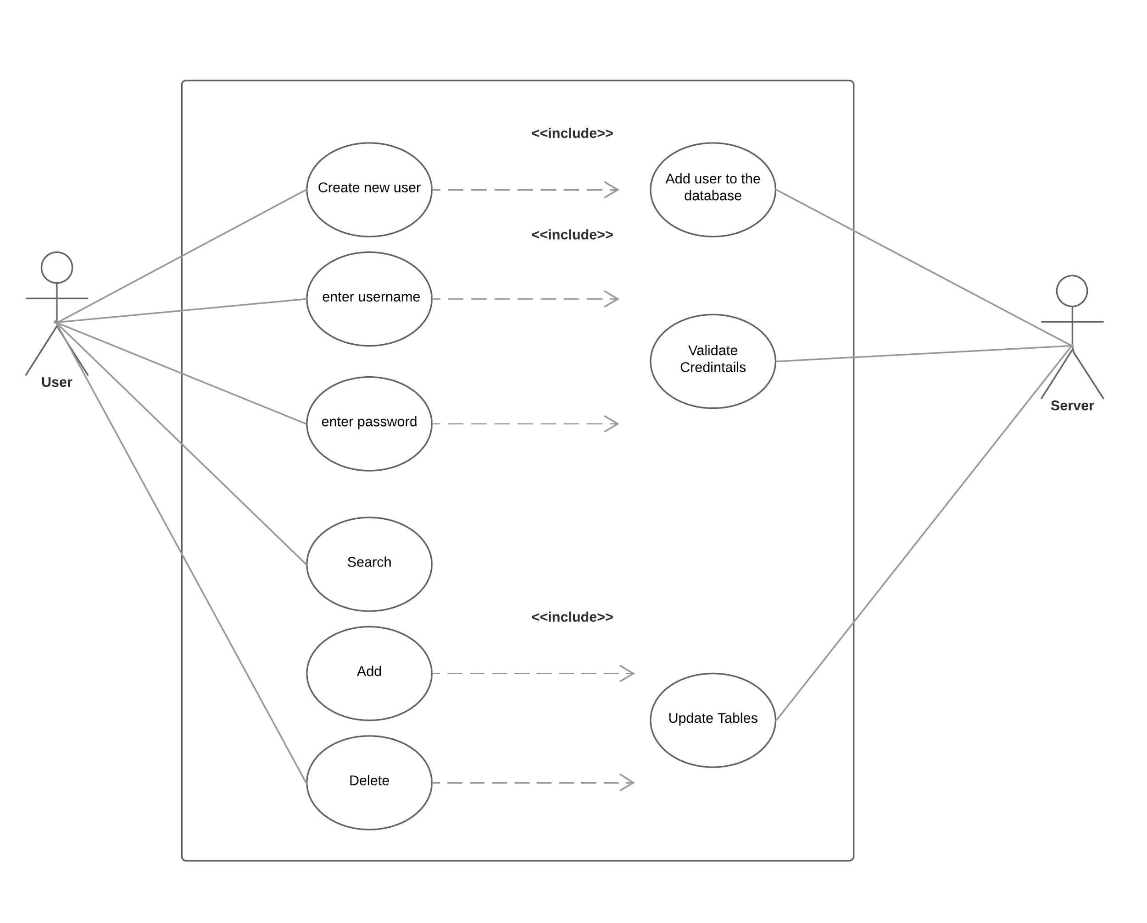
UML Use Case Diagram

Slide 6
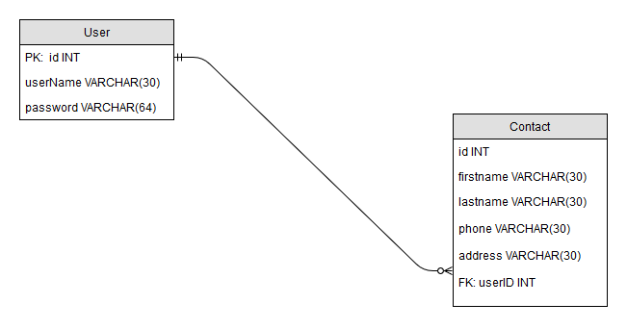
ER diagram

Slide 7
Difficulties
-Switched from WISA to LAMP stack
-Learning unknown languages
-Some used libraries had sparse documentation
- Integrating Python with Apache

Slide 8
Demo Time (Temporary Link)
IP address: 18.219.16.244

Slide 9

Questions

